Slide 1
Mandatory Practical: investigating surface area
Year 11 Biology
Bremer SHS

Slide 2
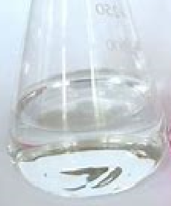
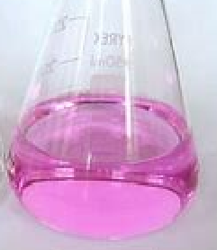
introduction
Phenolphthalein
(acidic)
Cells must exchange materials with their external environment at an efficient rate.
The size and shape of a cell can affect the area to volume ratio.
In this experiment:
Jelly cubes (sodium hydroxide and phenolphthalein) provide a simple model of a cell.
Phenolphthalein changes colour depending on the acidity of its surroundings.
Acid represents nutrients moving across the cell membrane in to the cytoplasm.
When acid diffuses in to the jelly, it neutralises the sodium hydroxide and causes the phenolphthalein to change colour.
Phenolphthalein
(alkali)

Slide 3
procedure
Pour 150mL of 0.1M sulphuric acid in to the 250mL beaker.
Cut blocks in to 10, 20, 30 and 40 mm² cubes.
Gently add the cubes to the acid beaker and gently stir every 2 minutes.
Remove the cubes after 10 minutes and pat them dry with paper towel.
Cut each cube in half and measure the depth of the clear parts to the nearest mm.
Complete calculations in the results table.

Slide 4
results
 | Cube Size (mm)
 | 10 | 20 | 30
Surface Area
Volume (X)
Surface Area to Volume Ratio
Dimensions of coloured cube
Volume of coloured cube (Y)
Volume of uncoloured portion (X - Y)
Percentage of block uncoloured

